Slide 1


DLLE CAREER PROJECT- LAWYER
D – Department
L – Life
L – Long
E – Extension

Slide 2

Who are Lawyers and what are their responsibilities ?
Lawyers, also known as attorneys, are certified professionals who advise and represent natural and juristic persons in legal matters. They counsel clients, perform legal research, prepare legal documents and represent clients in criminal and civil court proceedings.
Lawyer Responsibilities:
Monitor legal risk in documentation and giving guidance on the acceptable assumption of risk.
Interpret laws, rulings and regulations for natural and juristic persons.
Conduct legal research and gather evidence.
Ensure that appropriate approvals are in place before documents are executed.
Explain the law and give legal advice.
Offer legal representation at arbitration or mediation hearings.
Draft, review and manage wills, trusts, estates, contracts and deeds.

Slide 3
Working Condition Of Lawyer
Lawyers tend to enjoy a well-earned career after investing years in education and training as an associate. While the path from law student to a successful lawyer will be different for each person pursuing law, there are numerous similarities in lawyer’s working conditions.
Successful lawyers work hard and put in long hours at the office. It can be expected that lawyers will sacrifice their evenings and weekends to work with clients. This is due to many clients being preoccupied with their own 9 to 5 day jobs and cannot get time off work to visit a lawyer for legal aid.

Slide 4
Qualifications Of Lawyer
They must sit for various national level or University level entrance exams such as CLAT, AILET, LSAT etc. They must complete their 5 years Undergraduate course such as BA LLB, BCom LLB, BSc LLB. Students who have LLM degree can also become a lawyer.
To become a licensed and practicing lawyer, most students will need to complete four years of undergraduate study and three years of law school. While no specific undergraduate course of study is necessary, students can prepare for the practice of law by taking courses in areas such as philosophy, history, English and other humanities studies, in addition to mathematics and science classes. To be admitted to law school, students who have completed or will soon complete an undergraduate degree need to complete a standardized test and application process. Admission to law school can be quite competitive, and the required tuition can be expensive.

Slide 5
Employments opportunities for Lawyer
Law is an expansive sector with various opportunities. Depending on your interests and skills, you can pursue a unique career in this industry. Law is an expansive sector with various opportunities. The following are some of the most prominent and lucrative career options in law

Slide 6
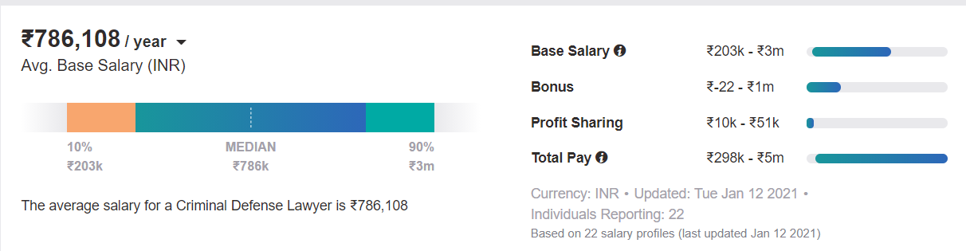
Employments opportunities for Lawyer
1. Criminal Lawyer
Criminal lawyers are responsible for representing their clients in court for criminal cases. They present cases in the court for their client in the local court, High Court, or the Supreme Court. Criminal lawyers argue their client’s case in front of a judge, question witnesses and the people related to their case, and review evidence.
Criminal Lawyer Salary in India
The average pay of a criminal lawyer in India is INR 7 lakh per annum. Beginners in this field earn around INR 2 lakh per annum while experienced criminal lawyers can earn up to INR 30 lakh per annum.

Slide 7
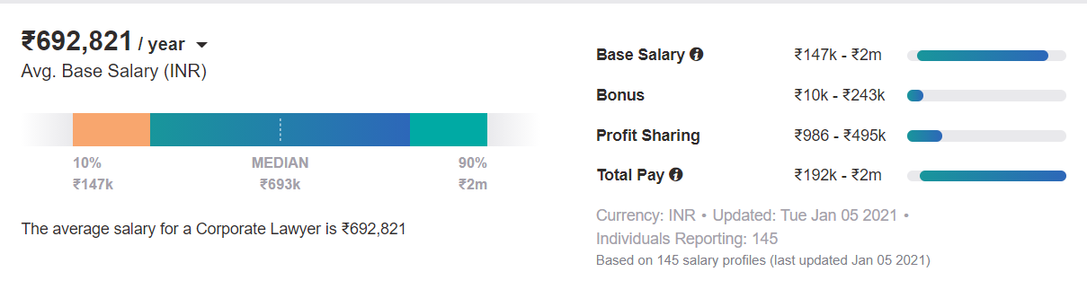
Employments opportunities for Lawyer
2. Corporate Lawyer
Corporate lawyers help companies in complying with the rules and regulations of their industry. They are responsible for assisting their client with all the legal processes related to a company’s formation and management.
As a corporate lawyer, you’d have to advise your client in claiming liability, business transactions, and represent in court during a trial. Corporate lawyers help their clients in reviewing and submitting legal documents related to their issues.
The average salary of a corporate lawyer in India is INR 6.9 lakh per year. As a beginner, you can expect to earn INR 1.47 lakh per annum including the base salary and the offered bonuses. The upper limit for this profession is quite high and your pay can go up to INR 20 lakh per annum. This field is among the best career options in the legal sector in terms of growth opportunities and income potential.

Slide 8
Employments opportunities for Lawyer
3. Judicial Services
A judge presides over court proceedings. They give the final verdict on a case after hearing arguments from both sides and evaluating the legal situation of the case. Judicial services are among the most respected careers in India.
To pursue a career in the judicial services of India, you would need to appear for the state-level exam for the judicial services.
The salary of a High Court judge in India is INR 2.2 lakh per month. Similarly, the salary of a Supreme Court judge in India is INR 2.5 lakh per month. As it’s a government job, it offers many additional allowances and perks.

Slide 9
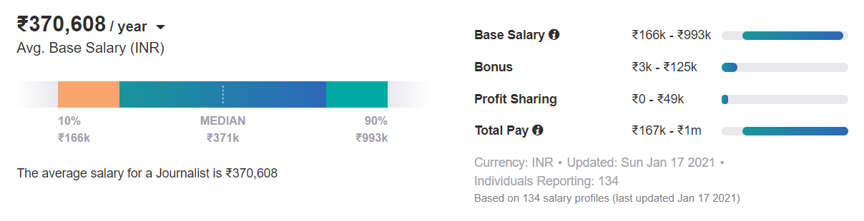
Employments opportunities for Lawyer
4. Legal Journalist
If you have a knack for writing, then you can pursue a career in legal journalism. Legal journalists attend court hearings and report the facts directly. They write articles for publications that could be online (blog, website, and social media) as well as offline (newspaper, magazine, etc.).
Legal journalists might take part in discussions on legal issues as they have a strong understanding of the law and current affairs.
This field requires strong communication skills and writing skills. However, it’s also possible for a legal journalist to work in visual media (television, YouTube, etc.) instead of being limited to writing. It’s certainly a unique career with a specific set of opportunities and challenges.
Legal Journalist Salary in India
The average salary of a journalist in India is INR 3.7 lakh per annum. Beginner-level professionals in this field earn around INR 1.6 lakh per annum however senior-level professionals can earn up to INR 9.89 lakh per annum. It’s among the best career .

Slide 10
Releated Occuptions
Occupation | Occupation | 2022 MEDIAN PAY
Judges and Hearing Officers | Judges and hearing officers apply the law by overseeing the legal process in courts. | $124,200
Paralegals and Legal Assistants | Paralegals and legal assistants perform a variety of tasks to support lawyers. | $52,920

Slide 11
Outlook for Lawyer
Employment of lawyers is projected to grow 9 percent from 2020 to 2030, about as fast as the average for all occupations. About 46,000 openings for lawyers are projected each year, on average, over the decade.

Slide 12
Advantages OF Lawyer
1. Wide Selection of Career Options
The benefits of being a lawyer include being able to select from a wide variety of career options in the public and private sector. If your calling is to make the world a safer place for you, your family, and everyone else, you may choose to become a criminal prosecutor. On the other hand, if you believe our criminal justice system is grounded on the principal that everyone is innocent until proven guilty and everyone has the right to competent legal counsel, you may choose to become a public defender. Of course, some people believe this but choose to be a criminal defense attorney in the private sector because private attorneys tend to earn a great deal more than attorneys in the public sector.

Slide 13
Advantages OF Lawyer
Financial Rewards and Emotional Rewards
Among the many benefits of being a lawyer, the financial rewards and emotional rewards are at the top of most college-bound students seeking to study law. Lawyers have the opportunity to earn a lucrative income. The average annual income for an attorney in the United States is $114,970 per year as of 2014 according to the U.S. Bureau of Labor. The highest 10% of attorneys earned more than $187,200 per year. Salaries of experienced, specialized attorneys can be much, much higher depending on the field, geographical location, employer, and level of experience.

